Slide 1
Correlation between “We The People” and Congress
Tim Blazek, Olivia Roy, Andy Shi
Social Sensing and Cyber-Physical Systems
Spring 2019

Slide 2
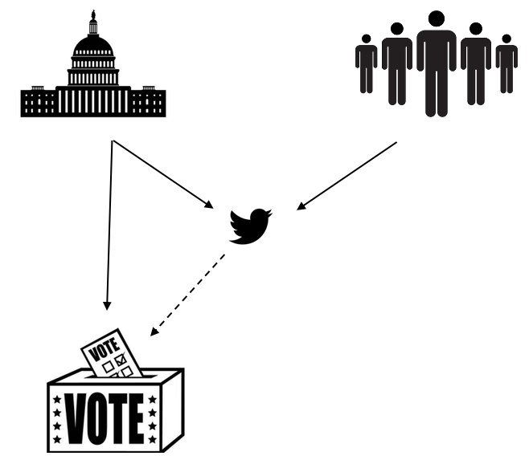
Motivation
Encourage writing and calling to Senators
Tweet political opinions and feelings
Do Senators accurately represent people?
75% of time vote with party

Slide 3
Challenges
Mapping Twitter user to corresponding Senator → lack of geo-location
Finding significant vote when votes were not strictly by party
Amdt. 270 – Vote to repeal Obamacare
July 25, 2017
Sentiment analysis
“Obamacare is death”
"We can do better than Obamacare”

Slide 4
Related Work
From Tweets to Polls: Linking Text Sentiment to Public Opinion Time Series
Compared public opinion from polls to sentiments measured from tweet
Every tweet counts? How sentiment analysis of social media can improve our knowledge of citizens' political preferences with an application to Italy and France
Analyzed voting intentions of users and the subsequent results in the French presidential and legislative elections of 2012
Does public opinion reflect reality of elections?
Social media in managing political advertising: A study of India
Another explored the relationship between tweet follows and shares gained by parties and the Delhi Assembly elections in India in 2015

Slide 5
Methods
GetOldTweets library
July 1–July 25
Tweets @ Senators
How Senators voted
TextBlob for sentiment analysis
JSON

Slide 6
Initial results
43,000 tweets with “Obamacare” between July 1, 2017 – July 25, 2017
73% negative
Remove repetitive usernames
30,000 users
Voting method to determine overall sentiment
76% negative
Partly line sentiments
87% of tweets at Republicans had a negative sentiment
72% of tweets at Democrats had a negative sentiment

Slide 7
Upcoming milestones
Improving sentiment analysis
Justifying the twitter population
Determining if correlation is exist

Slide 8
Questions

